Slide 1
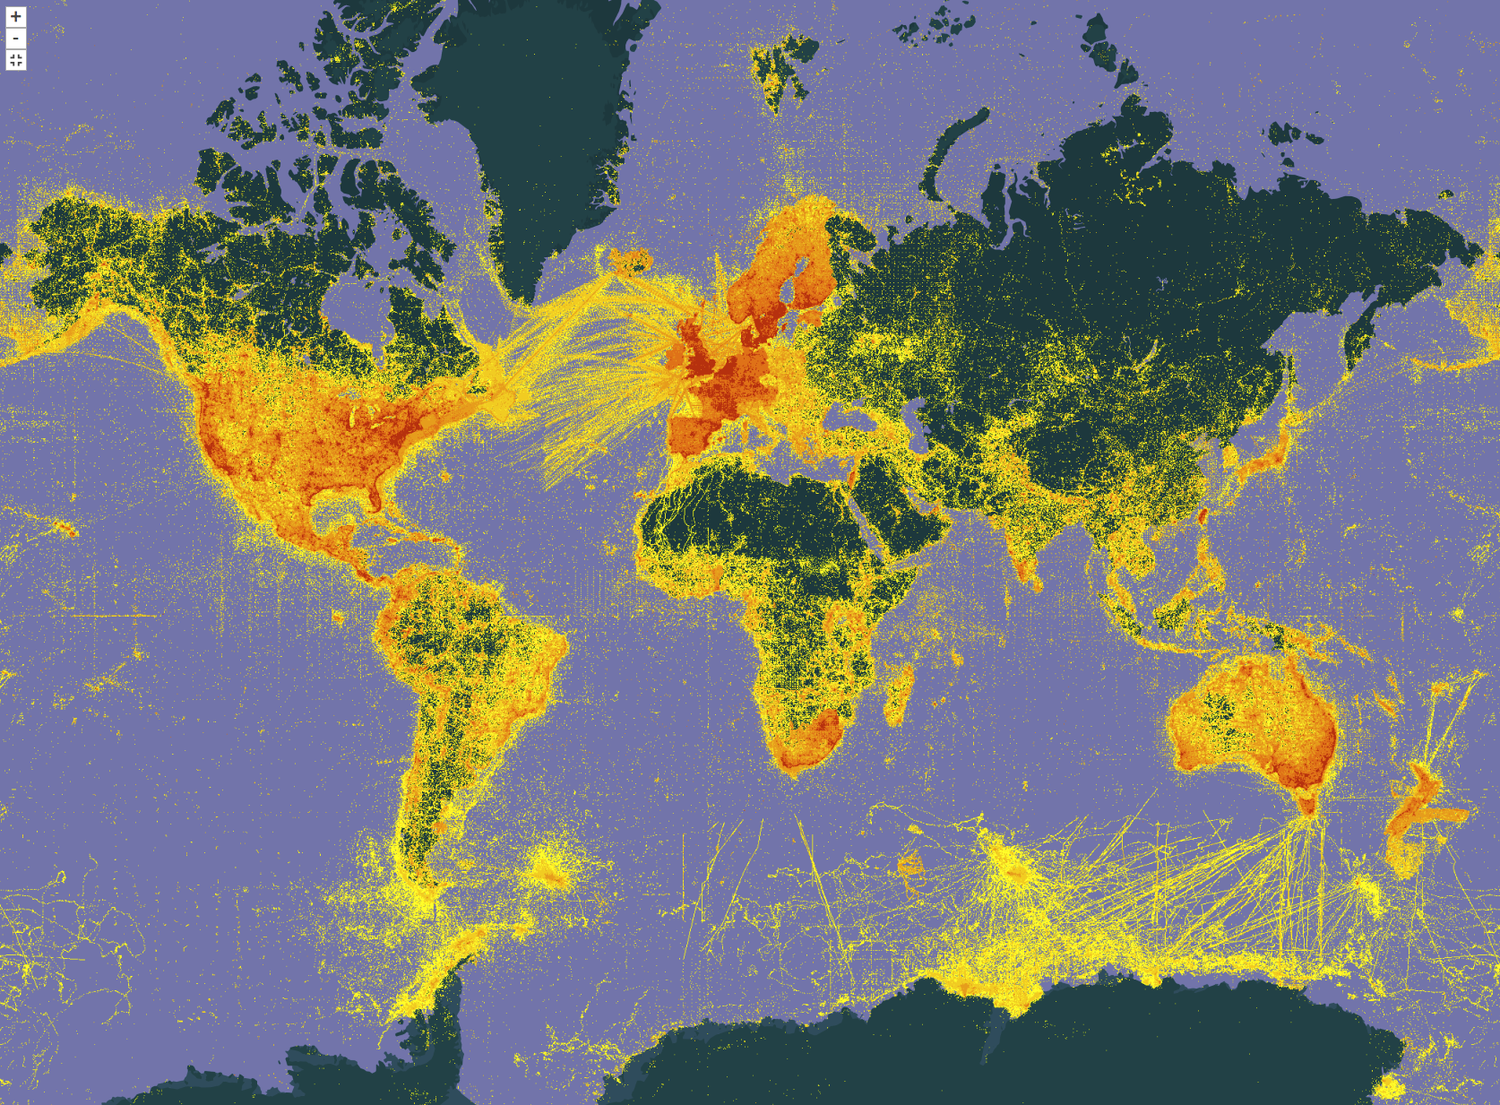




Biodiversity Data Wrangling
Ryan Folk, Daijiang Li, Robert Guralnick
Notes:
Introduce speakers

Slide 2
Introductions

Slide 3
Tentative Agenda
8:00 to 8:30 AM – TALK Ryan Folk, Intro and Introductions
8:30 to 9:00 AM – MAKE SURE YOUR COMPUTER WORKS
9:00 - 10:00 AM – TALK Ryan Folk, Macroevolution
10:00 AM – COFFEE/BREAK
10:30 AM - 12:00 PM – HANDS-ON Ryan Folk, Macroevolution
Lunch 12:00 to 1:00
1:00 – 1:30 — TALK Daijiang Li, spatial phylogenetics
1:30 – 3:00 — HANDS-ON Daijiang Li, spatial phylogenetics
3:00 – COFFEE
3:30 – 4:00 — TALK Robert Guralnick, phenology and phenometrics
4:00 – 4:30 HANDS-ON Robert Guralnick, phenology
4:30 – 5:00 — Closing notes, one-on-one

Slide 4
Make sure you are set up
Working R environment
Main libraries installed – refer to emails
E.g., “library(phytools)”

Slide 5
Collect data for practice sessions
If you are set up in Github Desktop or have git in UNIX:
git clone https://github.com/ryanafolk/Botany2024
Or, navigate in your browser to https://github.com/ryanafolk/Botany2024, download zip, and unzip somewhere on your local computer
Wifi ‘Botany Attendees’, password Botany2024

Slide 6
Topical coverage
“Needed is a relatively new set of skills to perform analytical integration: bringing distributions and phylogenetic trees together, bringing traits and distributions together, and other typical yet challenging tasks.”
“The purpose of this workshop is to showcase novel methods and applications of biodiversity data in a phylogenetic and spatial context, exposing attendees to several typical workflows and hopefully inspiring them with new ideas for their own scientific systems and datasets.”

Slide 7
Scenario
“I have a morphology dataset and a tree I’m happy with. But now I don’t know what I want to do with it and I’m stuck!”
“I have an ecological dataset and I want to test for phylogenetic structure, but I can’t find anything to get my data in the format phytools wants!”

Slide 8
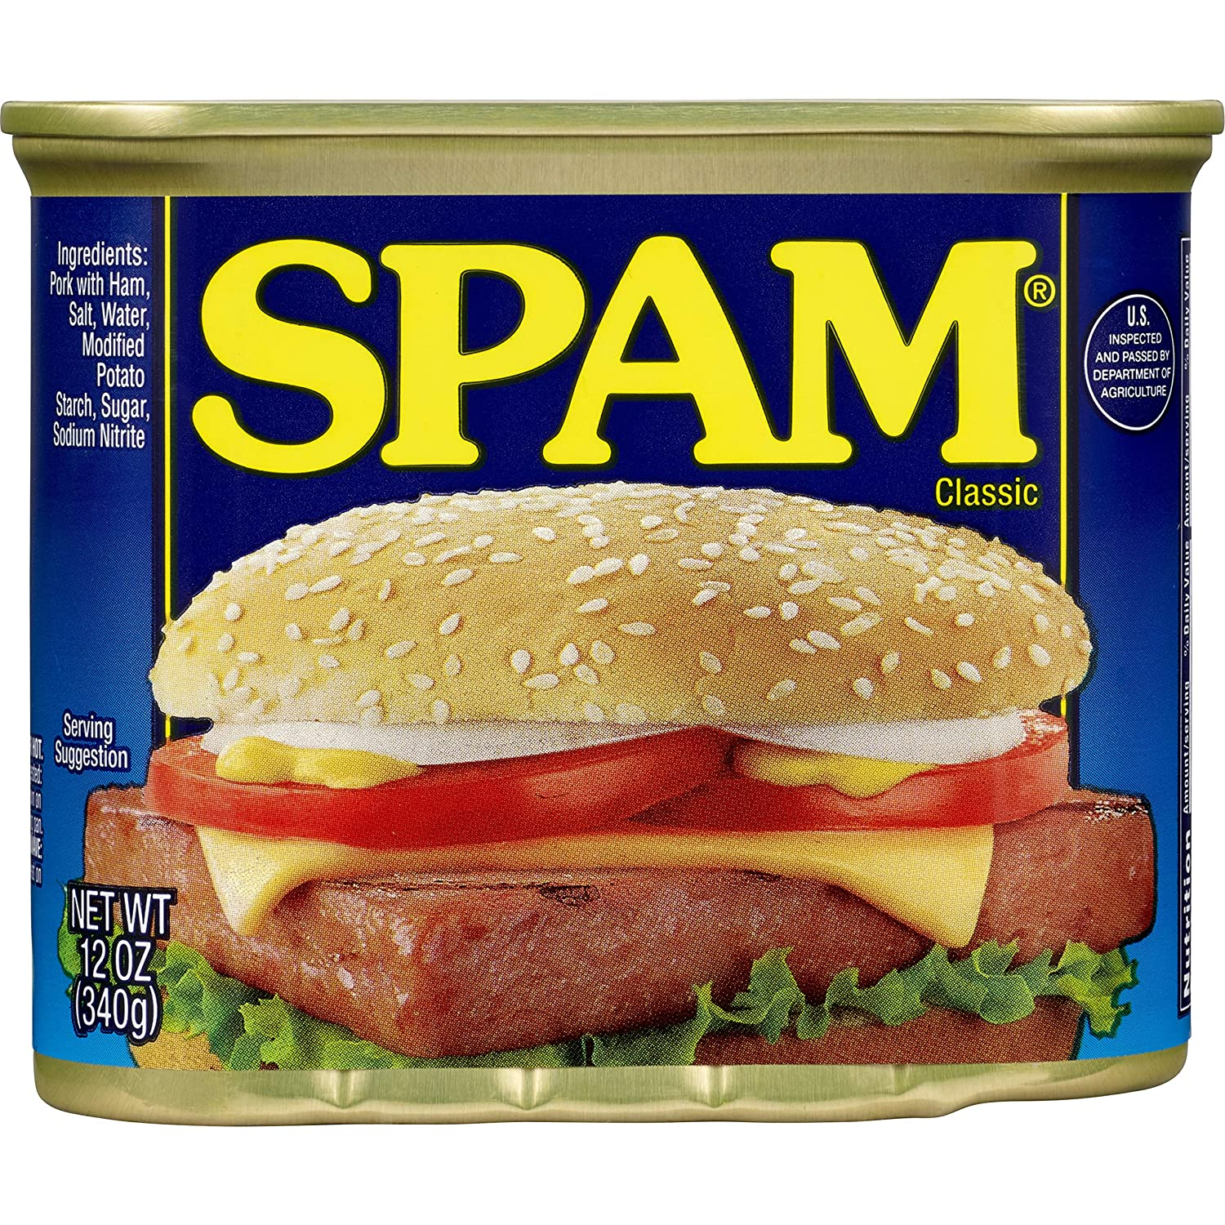

Philosophy
Put canned workflows out of your mind
What do we do when the R recipe doesn’t exist?
Example – we have diversification rates from BAMM, and we want to assess the relationship with environment, and control for phylogeny
Example – we have a giant community spreadsheet and we want to perform phylogenetic tests of membership in communities
Example – we have chemical data that we want to ordinate on a phylogeny

Slide 9
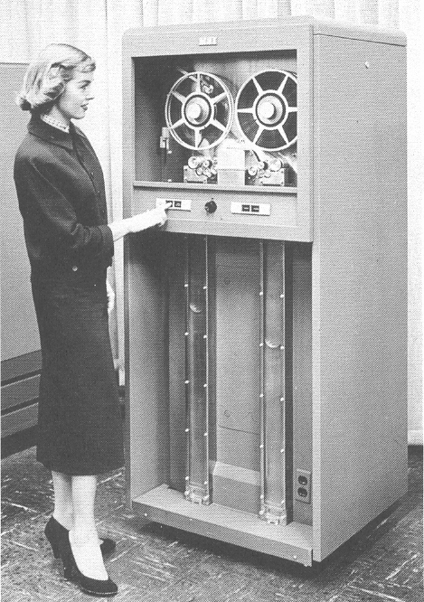

Philosophy
This is where we discuss dirty data, arcane formats, making data from different fields talk to each other
Don’t get stuck when the tutorials don’t work – learn Data Wrangling

Slide 10
Philosophy
Problems
Unanticipated data applications
We want to do something a program author didn’t anticipate
UPSTREAM
DOWNSTREAM

Slide 11
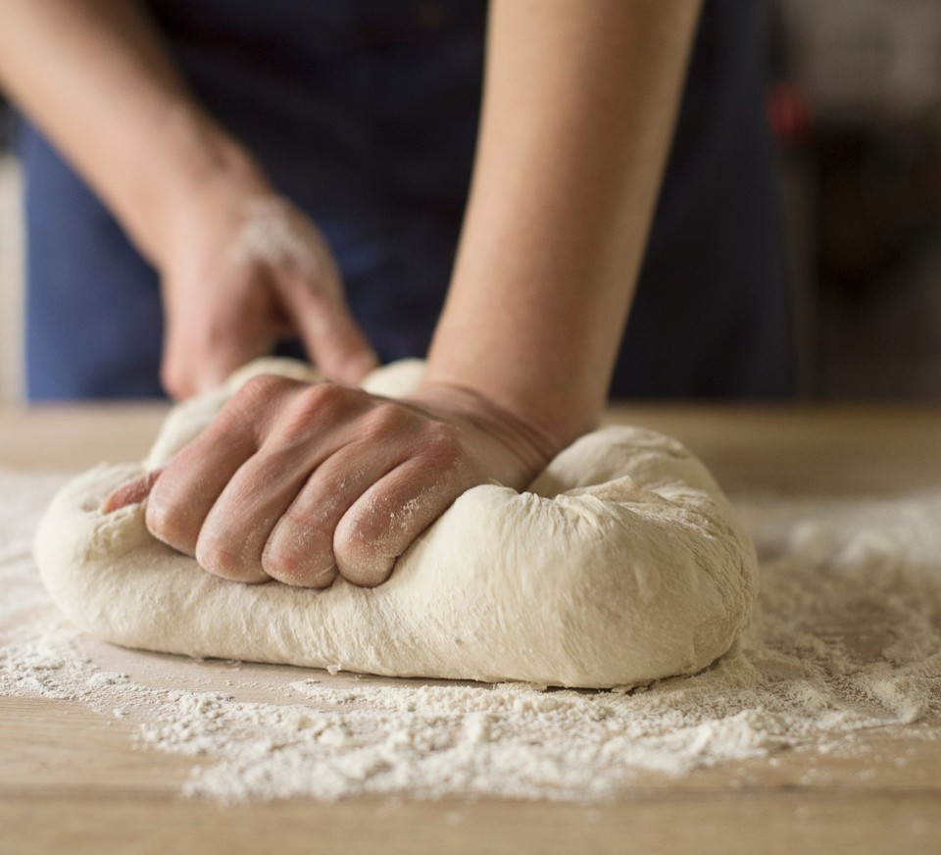
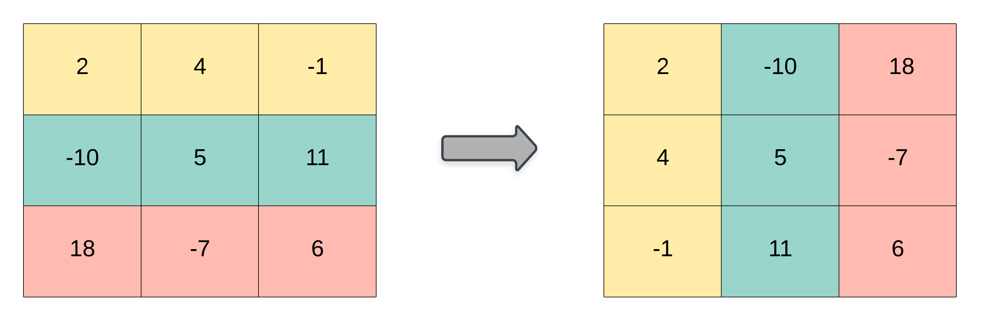
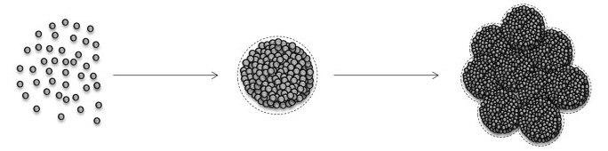
Philosophy
Aggregation, smoothing, and kneading problem
Data types conversion, reprocessing results

Slide 12

Philosophy
Another goal: Diverse applications
We have a diverse group – phylogenomicists, community ecologists, etc.
Hopefully leave today with new ideas about what to do with your data

Slide 13
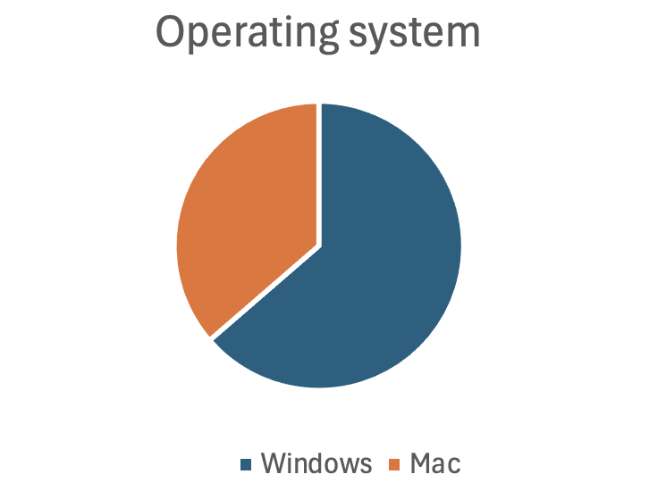

Slide 14
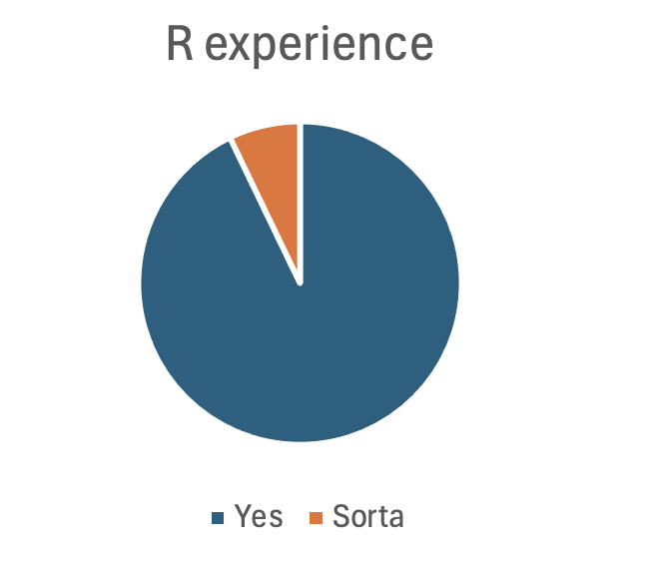

Slide 15
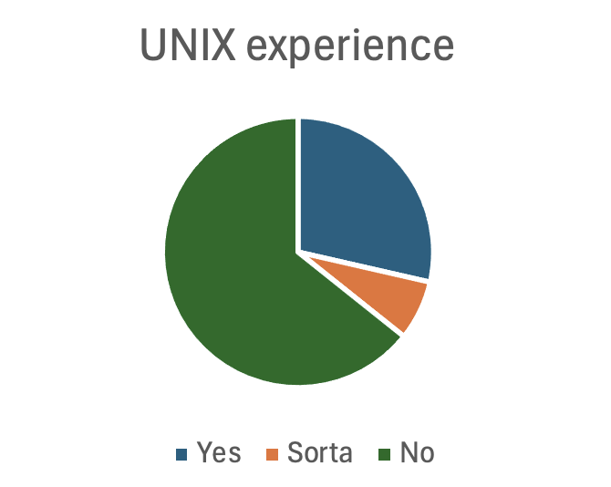

Slide 16
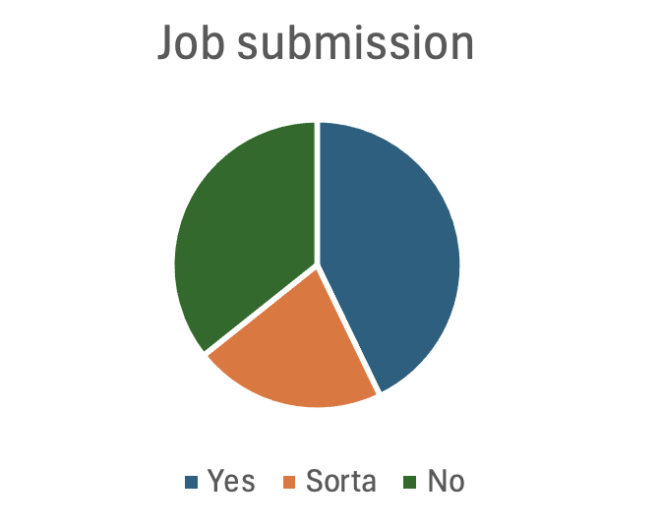

Slide 17
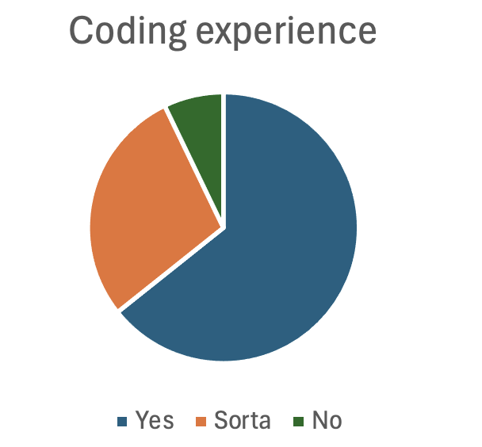

Slide 18
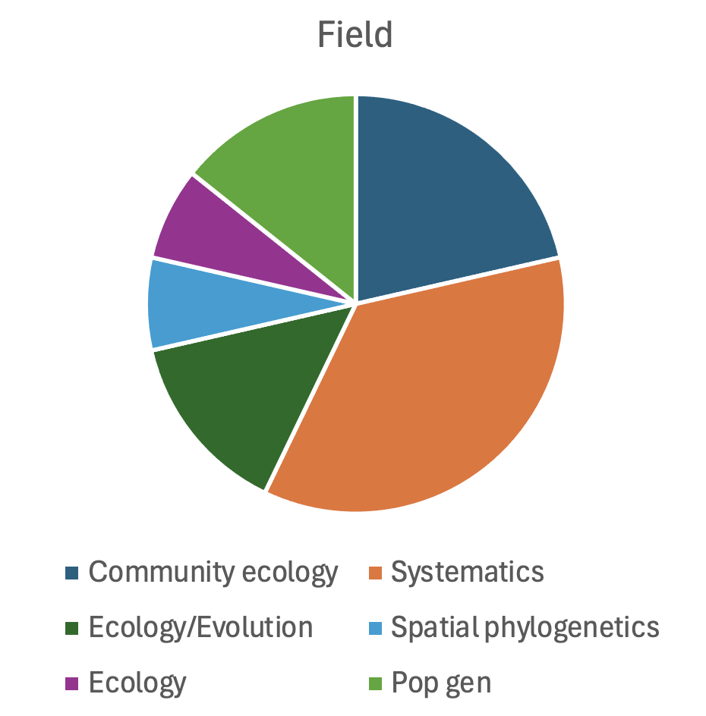

Slide 19
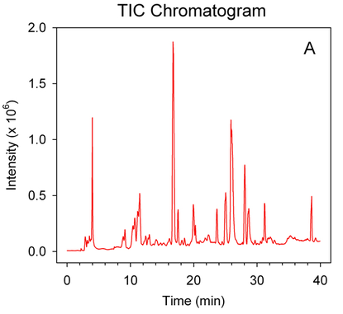
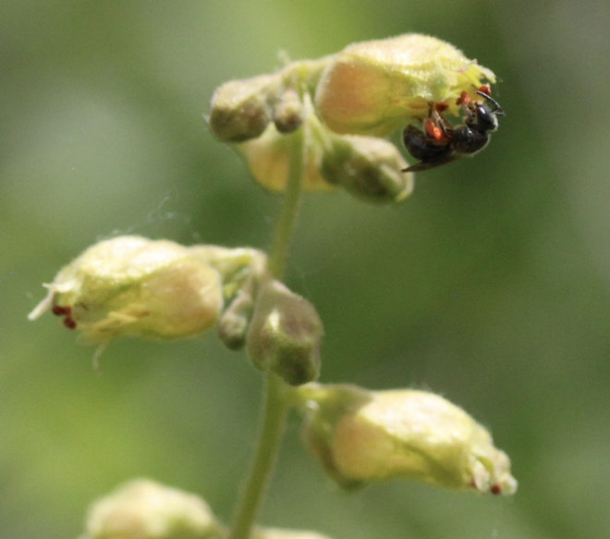
Example – GC-MS data

Slide 20
Example – GC-MS data
How to analyze chemical data in a phylogenetic context?

Slide 21
Example – GC-MS data
Steps – use backwards-design principles:
Thought process:
What kind of data I have
What I want to do
Process my data to make (1) look like (2)
Are there programs/libraries for what I want to do?
Has someone done this before under a different name?

Slide 22
Example – GC-MS data
Thought process:
I have a bunch of CSVs with raw machine output

Slide 23
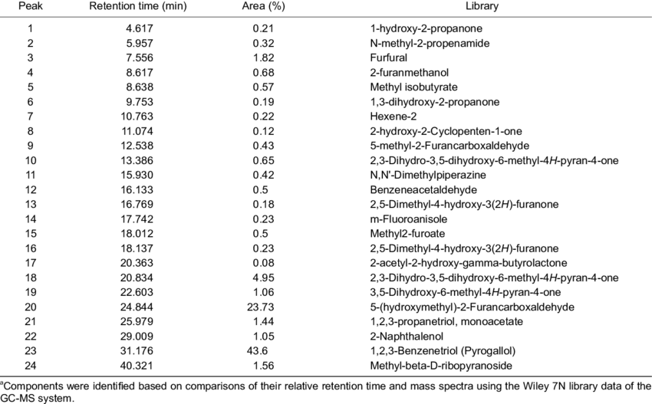
Example – GC-MS data
What the raw data look like:
Data come off the machine in one file per sample
Percent area is compound relative amount
We also have compound identifiers like retention time and identification

Slide 24
Example – GC-MS data
Thought process:
I have a bunch of CSVs with raw machine output
I want to perform an ordination to group my samples and test for differences
Represent the nature of the data
My chemical data are presence-absence with relative quantities

Slide 25
Example – GC-MS data
What we need:
My chemical data are presence-absence with relative quantities
Sounds like community data, like something an ecologist would do, not a chemist
But ecological libraries expect a certain data structure, and I don’t want to write my own code
 | 1 | 2 | 3 | 4 | 5 | 6
Species A | 0 | 10 | 0.7 | 20 | 0 | 0
Species B | 50 | 20 | 0 | 0 | 0 | 0
Species C | 0 | 5 | 15 | 70 | 0 | 10
Species D | 0 | 50 | 0 | 30 | 15 | 5
Species E | 0 | 50 | 0 | 30 | 10 | 10

Slide 26
Example – GC-MS data
Thought process:
Process my data to make barely formatted raw CSVs look like a typical ecological community matrix
I bet an R package exists that does this, but probably I should look at ecology sites online for an example

Slide 27
Example – GC-MS data
Typical logic – here I need to merge spreadsheets by sample
We need to merge on something we can use as an identifier
In a multispecies analysis, that could be accepted species name
In grid cell data we will show later, that might be lat-long
Here, it is a compound identity

Slide 28
Philosophy
Use backwards-design principles
Obtain data (outside this workshop)
Understand input data (your job!) – what are the data, and how are they represented (CSV, raw text, binary, etc.)
Get used to ”looking” at files
Understand output data (your job!) – what are you doing with the data, what data structures do tools assume
Restructure
(Possibly) clean and filter
(Possibly) validate, screen for problematic results

Slide 29
Make sure you are set up
Working R environment
Main libraries installed – refer to emails
Downloaded GitHub repository

Slide 30
Closing notes
Workshop funded by
First two years – NSF DEB 1916632, this year NSF DEB 2316266
Thanks to lecturers and participants
Happy to answer requests for further resources
Posted slides and all materials on GitHub!

Slide 31
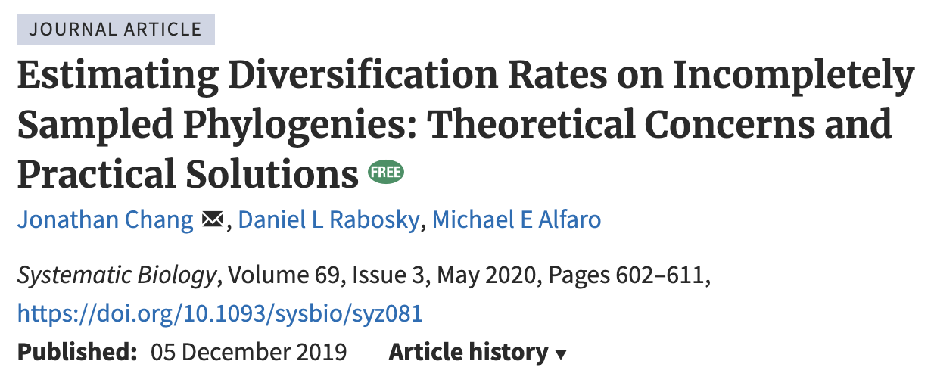
Questions
Recommended sampling completeness for downstream analysis
No clear recommendation – as much as you can
<5% is definitely not good
Higher level taxon trees are definitely not good

Slide 32
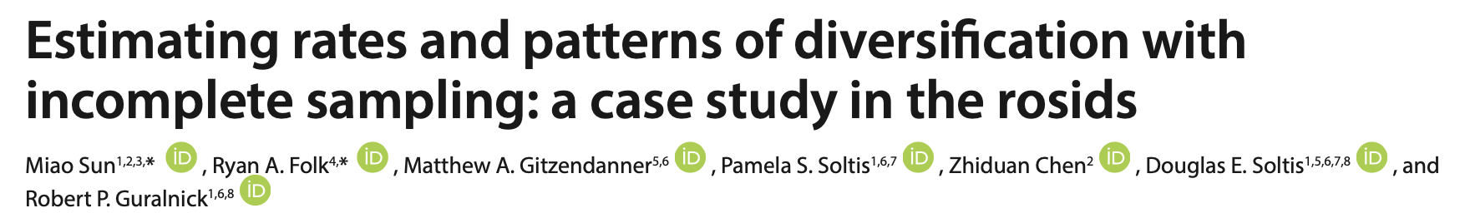
Questions
Sampling fraction parameters
Three main strategies:
Ignore
Parameterize
Synthesize new tips from taxonomy

Slide 33
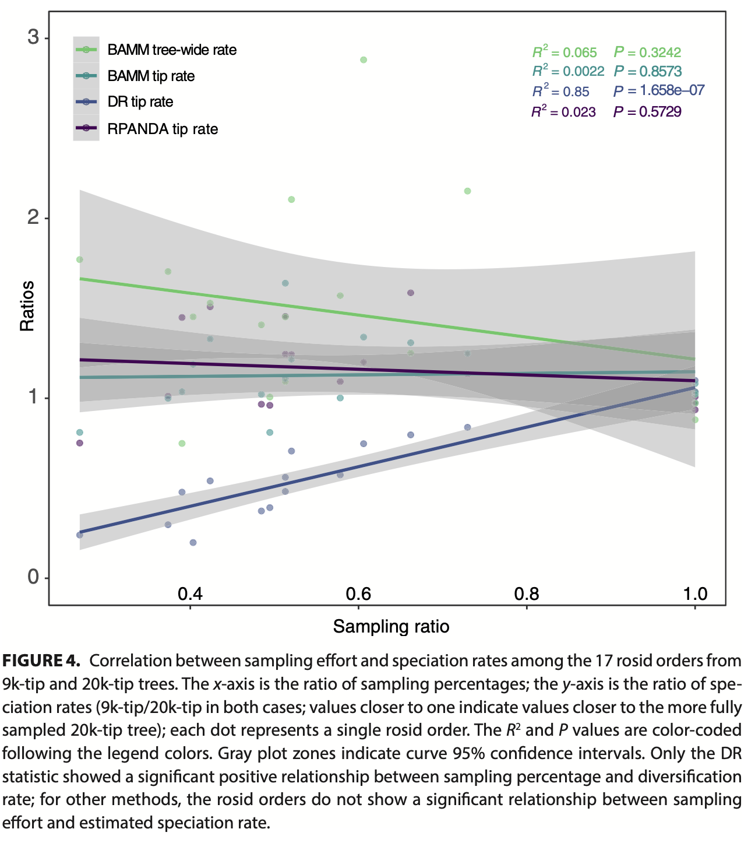
Questions
Sampling fraction parameters

Slide 34
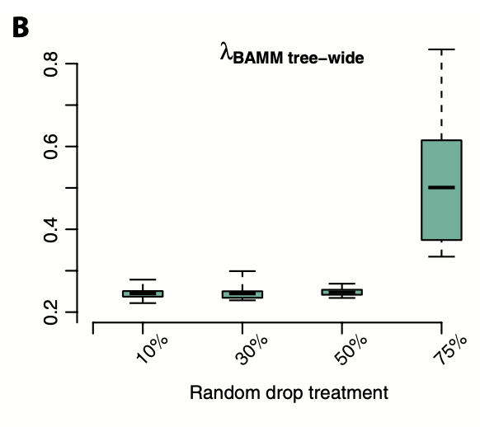
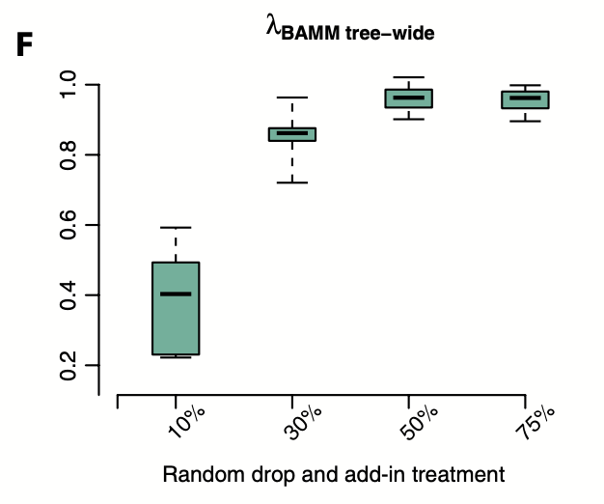
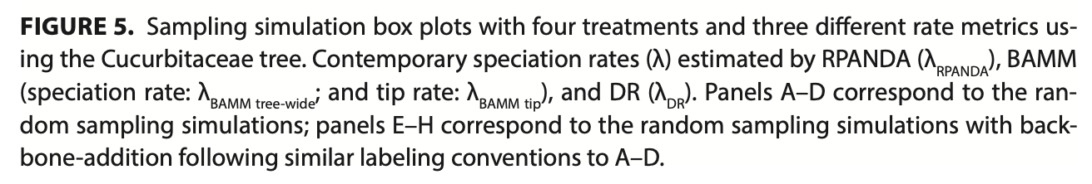
Questions
Sampling fraction parameters

Slide 35
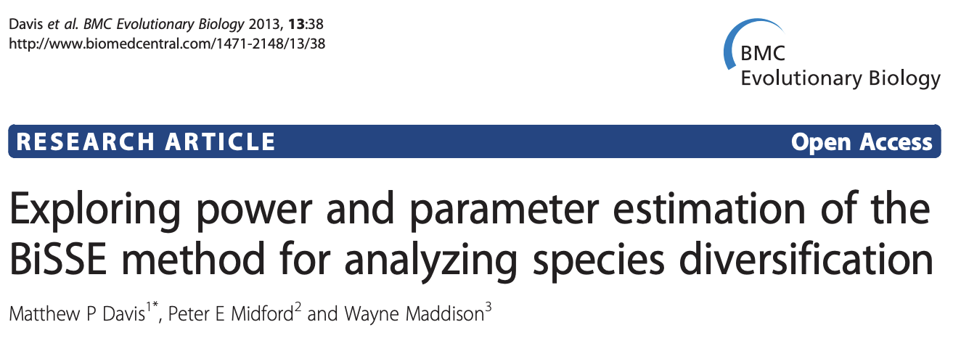
Questions
Small (well-sampled) trees
Try it!
Look at this paper though
Avoid semi-parametric – underpowered

Slide 36
Questions
Incorporating phylogenetic uncertainty
Bayesian – natural framework
Look at RevBayes
Bootstrapping
A bit like model averaging – summarize a set of analyses over set of trees

Slide 37
Question
Multidimensional traits – objective way to delineate
Hard for a lot of methods
Some methods intended for multivariate traits (e.g., Kmult, ancestral niche reconstruction, PGLMM, PGLS)
Consider distance methods and ordination – simplify either your data or the comparison
Presence/absence vs. abundance
They are different hypotheses

Slide 38
Question
P-values in large datasets
P-value definition
P-values are not intended to measure importance
Consider effect size estimates

Slide 39
Questions
Reconcile species names
POWO
World Checklist of Vascular Plants
ParseGBIF
Taxize
U.Taxonstand

Slide 40
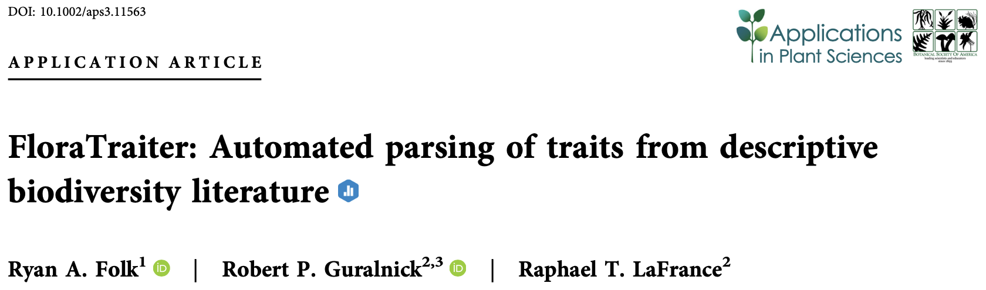
Questions
FloraTraiter/NLP

Slide 41
Questions
FloraTraiter/NLP
Natural language processing (rule-based parsing, predefined linguistic rules)
E.g., break down parts of grammar, determine the stem, identify word relationships
Use pre-built language models, add botanical vocabulary
Separate script to read and reconcile raw output

Slide 42
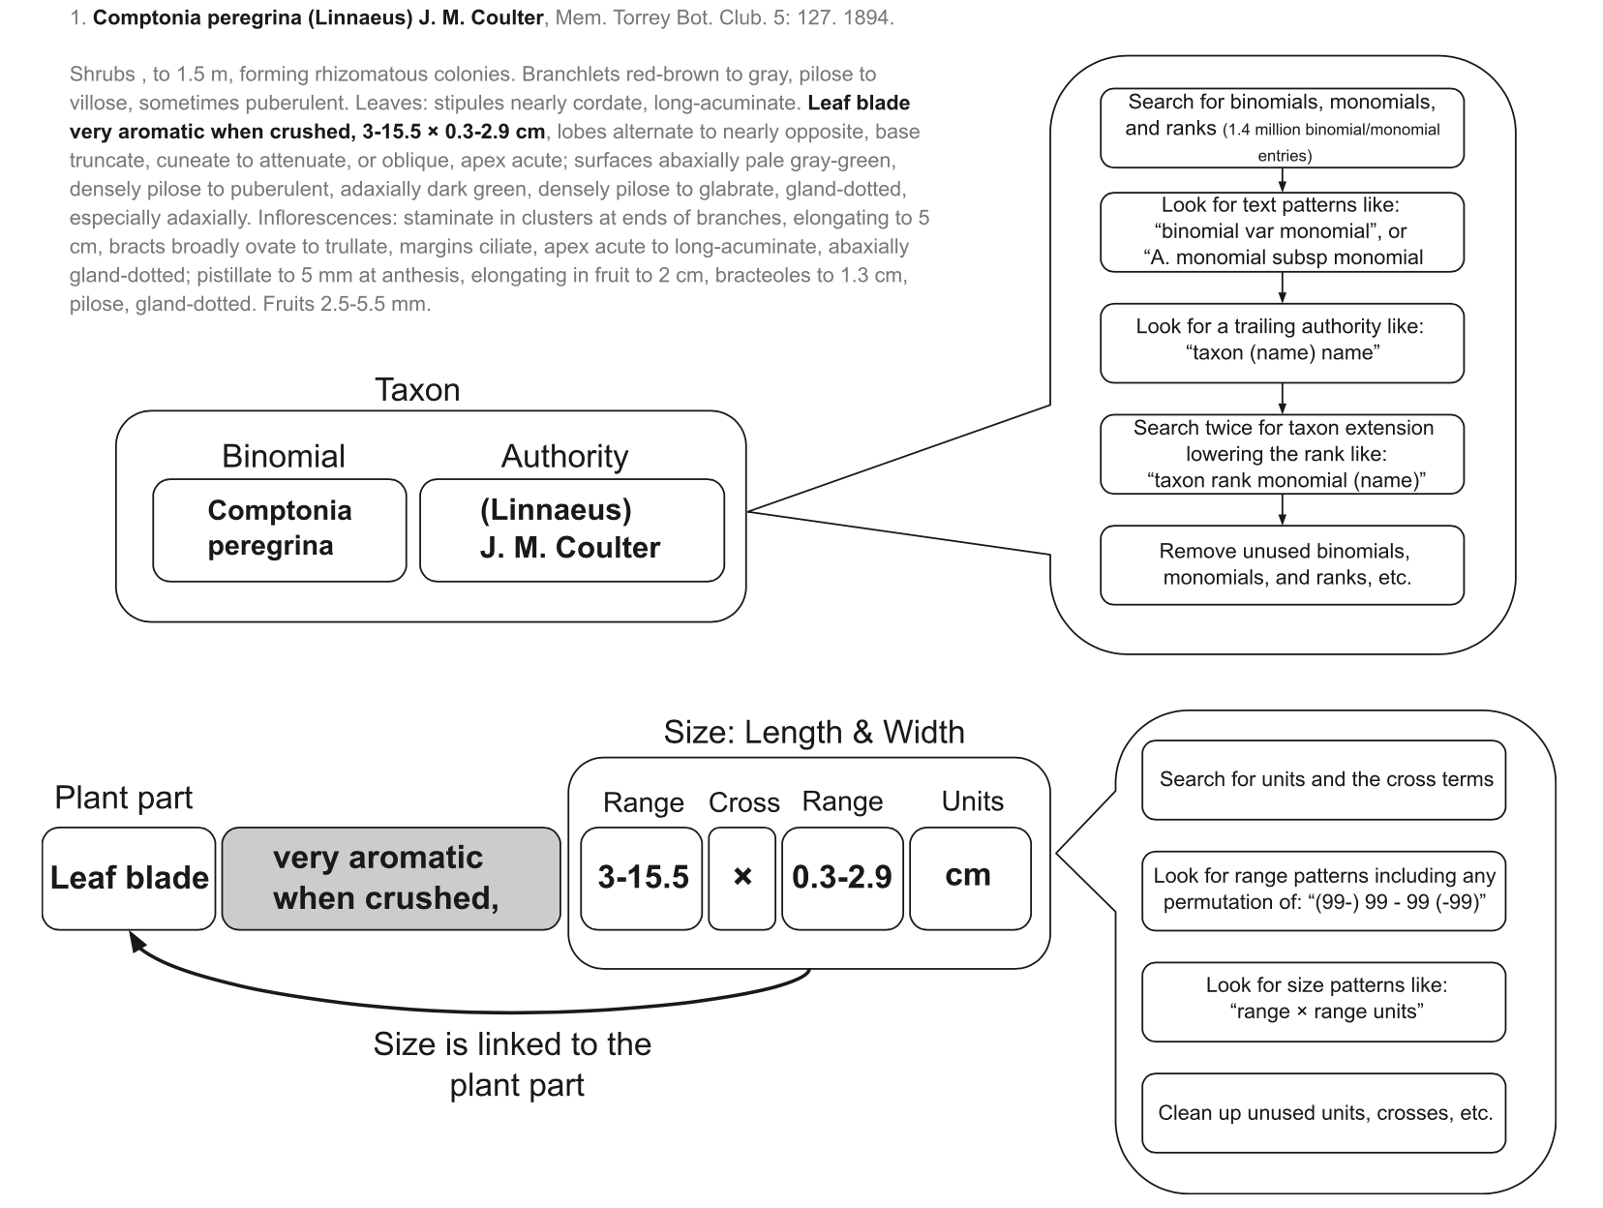

Slide 43
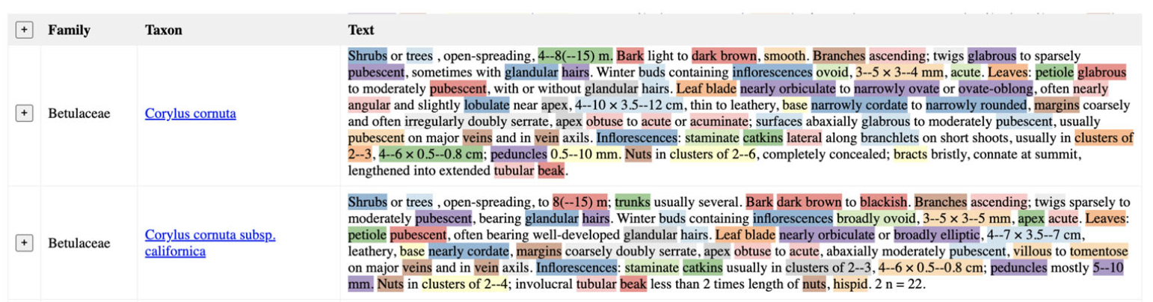
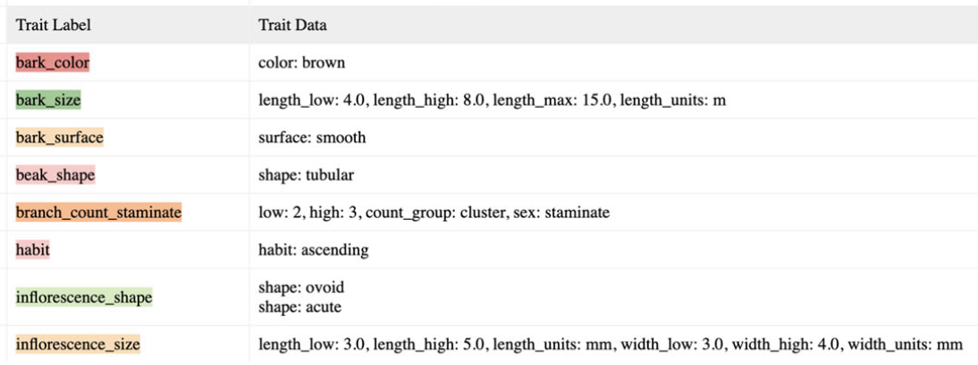

Slide 44
